Slide 1
STUDENT LOGIN SYSTEM
NAME:MATHESWARI D
REG.NO:43140080

Slide 2
Abstract
The Student Login System is designed to simplify and automate the process of recording register for students.
It allows students to register and log in, and teachers can view or manage attendance records.
This project uses HTML, JavaScript, Node.js, and MongoDB to create a simple web-based system.It reduces manual effort, improves accuracy, and saves time.

Slide 3
Existing System
Attendance is taken manually using paper registers.
Time-consuming and prone to human errors.
Difficult to generate reports or track student records.
Data is not secure or easily retrievable.

Slide 4
Proposed System
An online system that allows students to log in and mark attendance.
Attendance data is stored securely in a MongoDB database.
Admin or faculty can view student records anytime.Simple UI for quick access and updates.

Slide 5
Advantages
Reduces manual work and paperwork.
Easy to access attendance data from anywhere.
Data is securely stored in MongoDB.
Saves time for both students and teachers.
Can be easily expanded into a full attendance management system.

Slide 6
Disadvantages
Requires internet access to work.
If server or database fails, attendance cannot be marked.
Initial setup requires technical knowledge.

Slide 7
Hardware Requirements
Computer or Laptop
Minimum 4 GB RAM
Processor: Intel i3 or above
Stable Internet Connection

Slide 8
Software Requirements
Operating System: Windows / Linux / macOS
Tools: Visual Studio Code, MongoDB, Node.js
Languages: HTML, JavaScript

Slide 9
Modules
Register Module – New users register with name, register number, institute, email, and password.
Login Module – Registered users log in securely.
Attendance Module – Students mark attendance.
.

Slide 10
Module Description
Register Module:Stores user details in MongoDB.
Login Module:Authenticates users using email and password.
Attendance Module:Allows students to mark presence for the day.

Slide 11
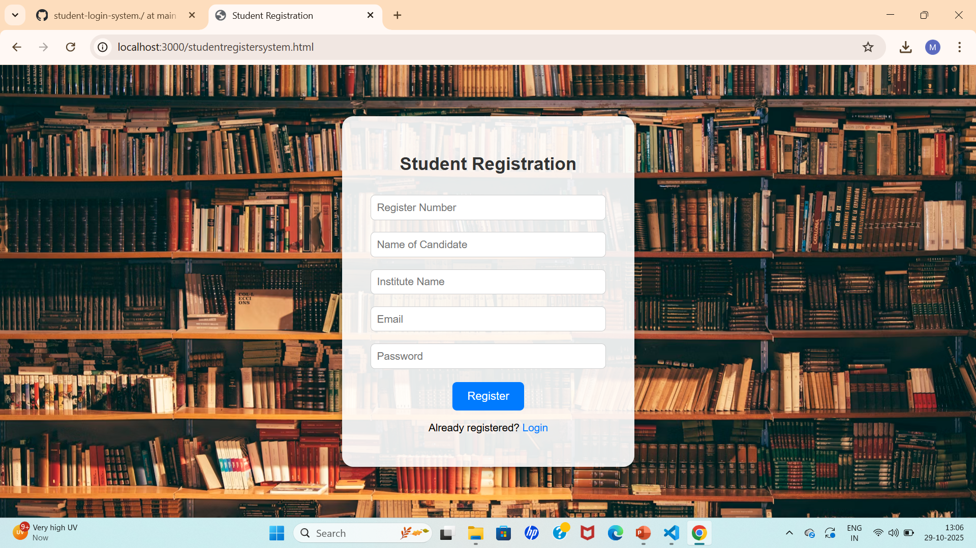
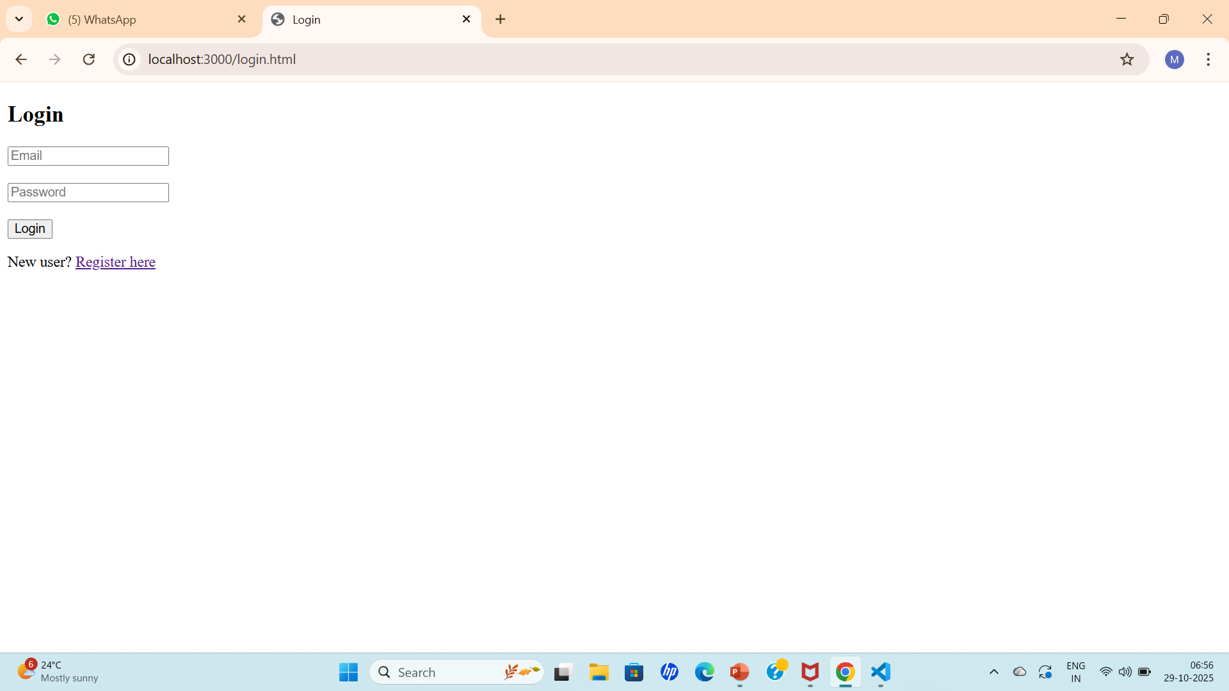
Sample Output

Slide 12
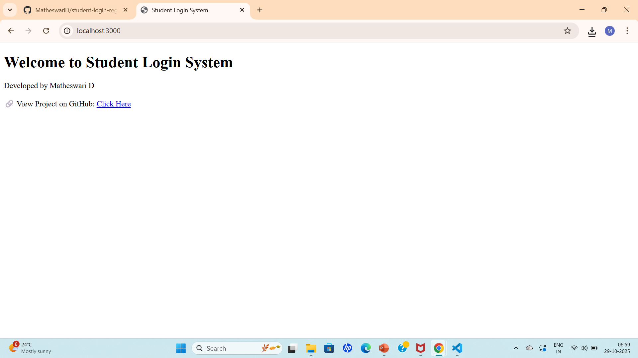
Sample output

Slide 13
Conclusion
The Student Attendance System successfully automates the process of marking attendance.
It saves time, ensures accuracy, and provides secure data management.
In the future, features like facial recognition or QR code scanning can be added to enhance functionality.

